Slide 1
Link analysis on customer shopping networks
James Wang
December 15, 2016

Slide 2
Background
The client, a leading global specialty food retailer, has developed a novel approach to identifying customers who shop together.
They would like to improve the efficiency of promotional spend via the loyalty program, and have provided us network data of their Seattle customers to explore.

Slide 3
Roadmap
High-Level Methodology
Link Analysis Results I: Revenue Analysis
Link Analysis Results II: Relationships Analysis
Business Recommendations
Concluding Thoughts
Notes:
should tell the entire story of deck.

Slide 4
High-Level Methodology

Slide 5
Defining the OKRs
Primary Objective
Our primary point of contact is the CMO, whose goal is to improve the efficiency of promotional spend via the existing loyalty program.

Slide 6
Defining the OKRs
Primary Objective
Our primary point of contact is the CMO, whose goal is to improve the efficiency of promotional spend via the existing loyalty program.
Key Results Needed
Define efficiency of spend
Quantify efficiency of spend
Implement efficient spending strategy

Slide 7
Defining the OKRs
Secondary Objectives
Explore data on full-graph level and zipcode-level
Deep dive into customer relationships

Slide 8
Defining the OKRs
Secondary Objectives
Explore data on full-graph level and zipcode-level
Deep dive into customer relationships
Key Results Needed
Are there links between the size / strength of networks and certain zip codes and neighborhood-types in Seattle?
How balanced are relationships?
Are customers often paired with others who have similar number of friends, or is it typically one sided?
Similarly for revenue – big spenders with big spenders or not?

Slide 9
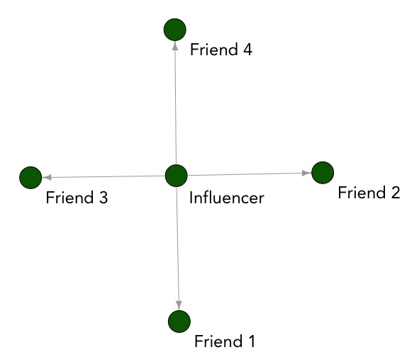

1. Define efficiency of spend
Maximize ROI on “loyalty program spending” by targeting our high-value customers.

Slide 10
1. Define efficiency of spend
Maximize ROI on “loyalty program spending” by targeting our high-value customers.
A high-value customer…
…is most likely to respond to the loyalty program
…generates the most revenue

Slide 11
2. Quantify efficiency of spend
Who should we be targeting?
Identify our high-value customers using network learning techniques
Who are our high-value customers?
Notes:
Who are we targeting?

Slide 12
2. Quantify efficiency of spend
Who should we be targeting?
Who are we targeting?
Identify our high-value customers using network learning techniques
Who are our high-value customers?
Pull data on customers who have been sent loyalty program promotions
Are they our high-value customers?
Notes:
Who are we targeting?

Slide 13
2. Quantify efficiency of spend
Who should we be targeting?
Who are we targeting?
Identify our high-value customers using network learning techniques
Who are our high-value customers?
Pull data on customers who have been sent loyalty program promotions
Are they our high-value customers?
Are we targeting the right customers with our loyalty program?
Notes:
Who are we targeting?

Slide 14


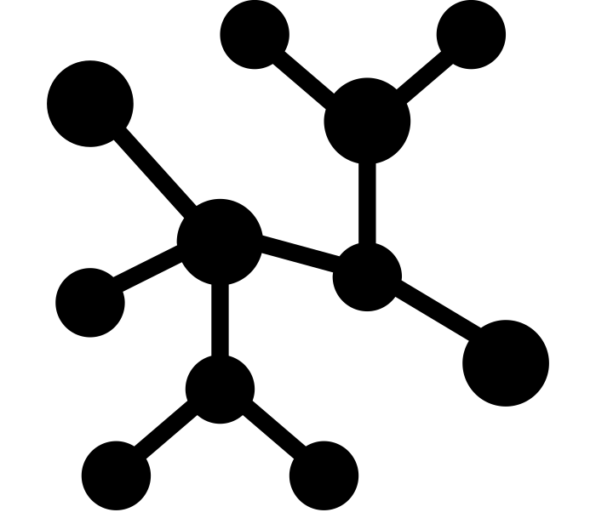
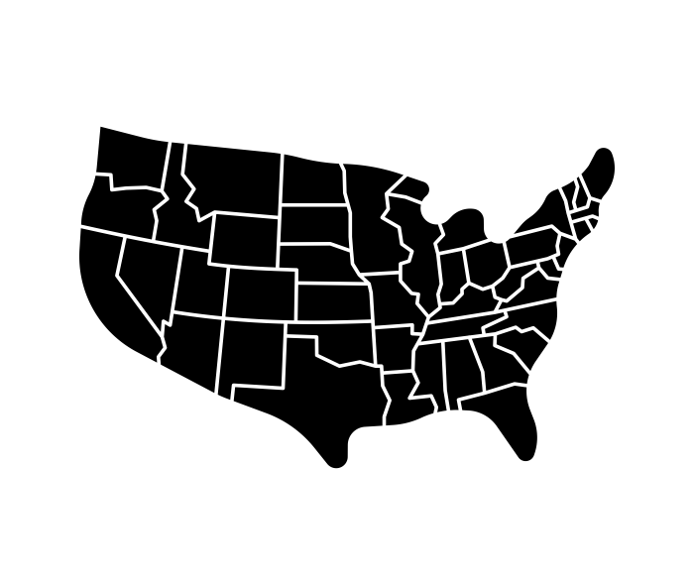
Identifying high-value customers
Tactic 1: Customers who individually spend the most
Tactic 2: Customers whose 1st degree connections spend the most
Tactic 3: Customers whose sub-graph spends the most
Tactic 4: Zip codes who spend the most

Slide 15

3. Implement efficient spending strategy
Test effectiveness of new strategy with experiment
Monthly Revenue ($)
High-value customers
Treatment
Control
Low-value customers
Treatment
Identify high-value customers
Set up treatment and control groups
Control
Run experiment for 3-6 months
Evaluate results
Define metric to track and forecast metric performance
Causal Inference:
Is difference in actual metric performance and forecasts statistically significant?
Track metric

Slide 16
3. Implement efficient spending strategy
Test effectiveness of new strategy with experiment
Monthly Revenue ($)
High-value customers
Treatment
Control
Low-value customers
Treatment
Identify high-value customers
Set up treatment and control groups
Control
Run experiment for 3-6 months
Evaluate results
Define metric to track and forecast metric performance
Causal Inference:
Is difference in actual metric performance and forecasts statistically significant?
Track metric

Slide 17
3. Implement efficient spending strategy
Test effectiveness of new strategy with experiment
Monthly Revenue ($)
High-value customers
Treatment
Control
Low-value customers
Treatment
Identify high-value customers
Set up treatment and control groups
Control
Run experiment for 3-6 months
Evaluate results
Define metric to track and forecast metric performance
Causal Inference:
Is difference in actual metric performance and forecasts statistically significant?
Track metric

Slide 18
3. Implement efficient spending strategy
Test effectiveness of new strategy with experiment
Monthly Revenue ($)
High-value customers
Treatment
Control
Low-value customers
Treatment
Identify high-value customers
Set up treatment and control groups
Control
Run experiment for 3-6 months
Evaluate results
Define metric to track and forecast metric performance
Causal Inference:
Is difference in actual metric performance and forecasts statistically significant?
Track metric

Slide 19
3. Implement efficient spending strategy
Test effectiveness of new strategy with experiment
Monthly Revenue ($)
High-value customers
Treatment
Control
Low-value customers
Treatment
Identify high-value customers
Set up treatment and control groups
Control
Run experiment for 3-6 months
Evaluate results
Define metric to track and forecast metric performance
Causal Inference:
Is difference in actual metric performance and forecasts statistically significant?
Track metric

Slide 20
Link Analysis Results I
Identifying high-value customers in terms of revenue

Slide 21
Properties of the data
Raw Data
List of customer shopping duos (n = 7792) and corresponding strength of relationship (1 to 10) and zip codes (n = 26)
List of customer IDs and their spending (n = 9628)

Slide 22
Properties of the data
Raw Data
List of customer shopping duos (n = 7792) and corresponding strength of relationship (1 to 10) and zip codes (n = 26)
List of customer IDs and their spending (n = 9628)
Features to create
Measures of revenue, measures of node centrality, measures of connectedness, zip code demographics

Slide 23
Properties of the data
Raw Data
List of customer shopping duos (n = 7792) and corresponding strength of relationship (1 to 10) and zip codes (n = 26)
List of customer IDs and their spending (n = 9628)
Features to create
Measures of revenue, measures of node centrality, measures of connectedness, zip code demographics
Transformations of features
Log certain features (e.g. revenue) to normalize

Slide 24
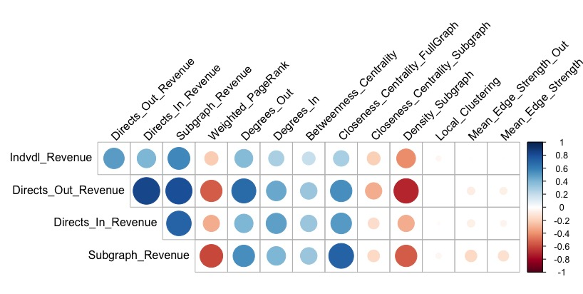
Correlation Analysis
_In
n = 9628

Slide 25
Tactic 1: Individual Revenue
Most important factors*
Insight 1:
The customers who spend the most are typically part of high spending, low density subgraphs. Interestingly, the more “close” a customer is to all other customers in the full graph, the less they spend.
Name | Relationship
Subgraph Revenue | +++
Closeness (Full Graph) | – –
Weighted PageRank | ++
Density (Subgraph) | – –
High-Value Customers
Insight 2:
Customers spend more when they are connected with more friends that pull them to shop (and in turn, those friends are pulled by their own friends to shop, etc). These customers are “popular” in their circles.
3153 | 2336
3354 | 2357
1534 | 2931
1549 | 19
*Cross-validated (5-fold) L1-regularized OLS regression and random forest regression, n = 1880, p = 13

Slide 26
Tactic 2a: Directs (Out-Degree) Revenue
Most important factors*
Insight 1:
Combined revenue of a customer’s friends (out) is positively related with the combined revenue of a customer’s friends (in), even though the customer him/herself may not be a high-spender. This relates to subgraph revenue.
Name | Relationship
Directs Revenue (In-Degree) | ++
Subgraph Revenue | ++
Density (Subgraph) | – –
Closeness (Full Graph) | – –
High-Value Customers
Insight 2:
Again, it seems that if your subgraph is not as highly connected (everyone is friends with everyone else), there is more spending. Furthermore, it seems customers that are closest to everyone on the graph also have friends who have lower spending.
1816 | 2336
2926 | 1971
2931 | 3560
2928 | 1814
*Cross-validated (5-fold) L1-regularized OLS regression and random forest regression, n = 1880, p = 13

Slide 27
Tactic 2b: Directs (In Degree) Revenue
Most important factors*
Insight 1:
The friends who bring a customer to shop are high-spending if the customer shops with other high-spenders, and additionally, is part of a high-spending subgraph.
Name | Relationship
Directs Revenue (Out-Degree) | +++
Subgraph Revenue | ++
Density (Subgraph) | ++
Closeness (Full Graph) | +
High-Value Customers
Insight 2:
Surprisingly, unlike the previous two tactics, being part of a customer’s higher density subgraph means more spending. Furthermore, higher closeness in regards to the whole graph means the more people the customer knows, the more those who want to shop with the customer will spend. This reinforces the popularity notion.
1434 | 249
3634 | 252
1859 | 3552
3388 | 4191
*Cross-validated (5-fold) L1-regularized OLS regression and random forest regression, n = 1880, p = 13

Slide 28
Tactic 3: Subgraph Revenue
Most important factors*
Insight 1:
As expected, the other revenue types all positively relate to subgraph revenue quite strongly.
Name | Relationship
Closeness (Full Graph) | +++
Directs Revenue (Out-Degree) | ++
Weighted PageRank | – –
Directs Revenue (In-Degree) | +
Individual Revenue | +
High-Value Customers
Insight 2:
The closer the customer is to the rest of the graph, the more their subgraph spent.
1813 | 1840
1823 | 1972
1816 | 3361
1814 | 929
*Cross-validated (5-fold) L1-regularized OLS regression and random forest regression, n = 1880, p = 13

Slide 29
Tactic 4: Average Zipcode Revenue
Most important factors*
Insight 1:
Network attributes (density of zipcode, average relationship strength) did not appear to be important.
Name | Relationship
Population Density | –
Median Age | +
High-Value Zipcodes
Insight 2:
Demographic attributes are weakly related with average customer spend by zipcode. More spending occurred in less populated zip codes and areas with a higher median age.
See customer targeting database.
*Cross-validated (5-fold) L1-regularized OLS regression and random forest regression, n = 23, p = 8

Slide 30
What can we conclude from insights?
The different types of revenue are very important when explaining one another, especially subgraph revenue.
Some combination of node closeness in the full graph, weighted PageRank, and density of a node’s entire subgraph are key drivers of revenue.
With n = 23 and weak importance, more data is needed to conduct an intra-zipcode level analysis.
See Appendix for inter-zipcode level analysis.
Notes:
Link insights here

Slide 31
What can we conclude on customers?
Customers whose subgraphs spend highly are more likely to spend highly themselves. This type of effect may be attributed to socioeconomic reasons.
Density, closeness, and weighted PageRank seemed to flip-flop (in terms of direction of relationship) between different types of revenue. We may want to defer to domain expertise or customer surveys to better understand this behavior.

Slide 32
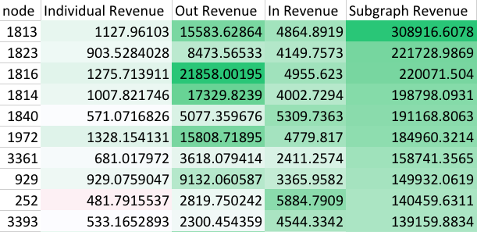
What can we conclude on customers?

Slide 33
Link Analysis Results II
Investigating relationships between our customers

Slide 34
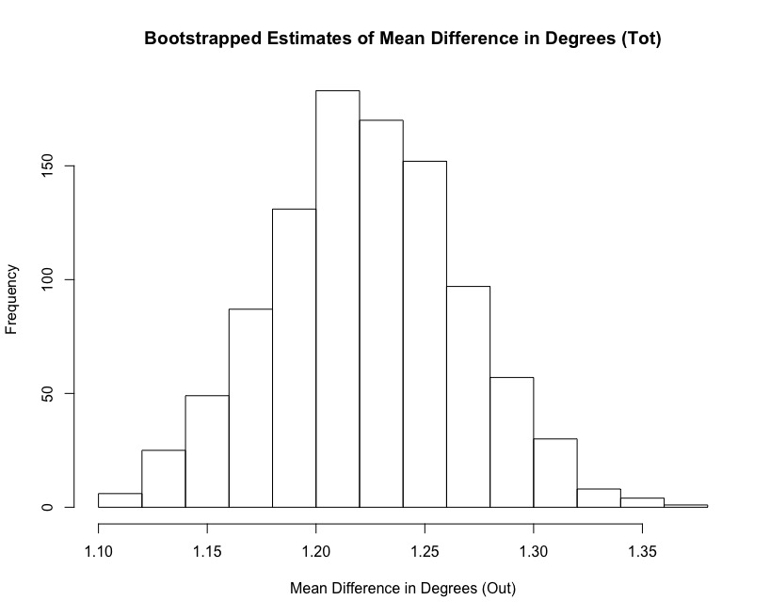
Are customers often paired with others who have similar number of friends, or is it typically one sided?
Total Degrees
Result: Customers typically have 1-2 more total friends than the friends they interact with.
Insight:
Customers typically have the same network size (amount of friends).

Slide 35
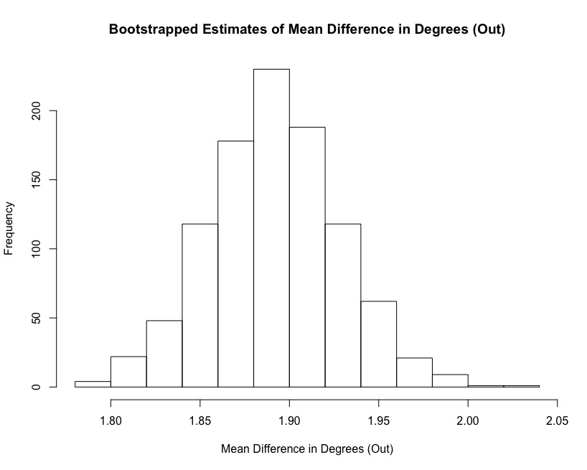
Are customers often paired with others who have similar number of friends, or is it typically one sided?
Out Degrees
Result: Customers typically have 1-2 more friends they interact with than the friends they interact with.
Insight:
Customers shop with more friends than their friends shop with their friends. It appears “paired shopping” is not a trickle-down behavior.

Slide 36
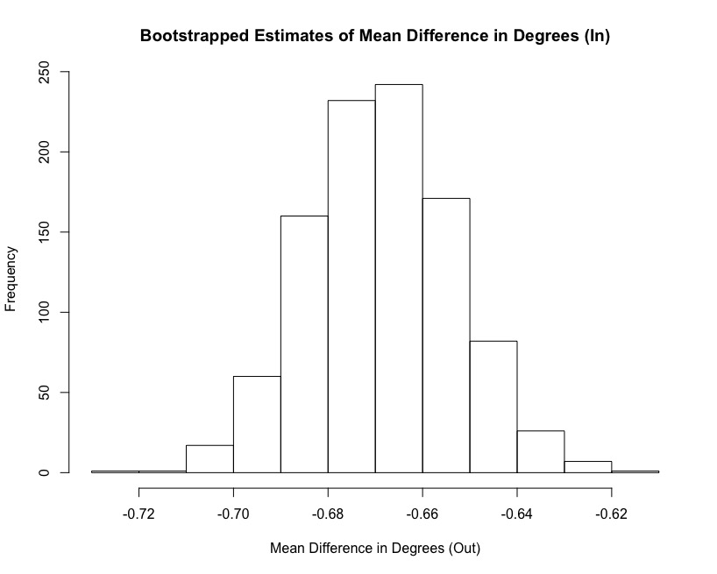
Are customers often paired with others who have similar number of friends, or is it typically one sided?
In Degrees
Result: Customers typically have 1 fewer friends interacting with them than the friends they interact with.
Insight:
Customers are more often pulling others to shop than being pulled by others to shop.

Slide 37
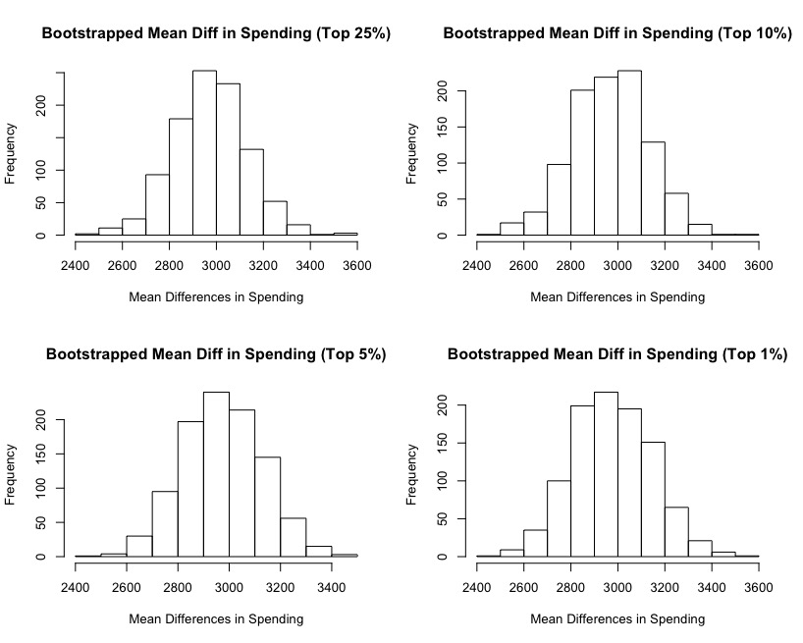
Are customers often paired with others who have similar spending of friends, or is it typically one sided?
High Spenders
Result: High spenders tend to spend $3000 more on average than the friends they shop with.
Insight:
High spenders typically do not shop with other high spenders.

Slide 38
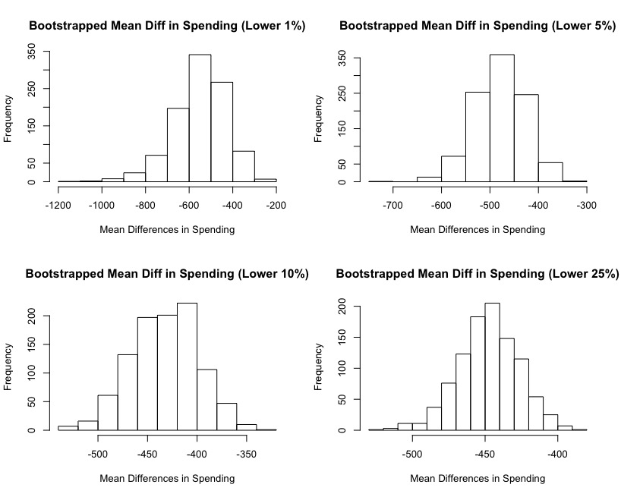
Are customers often paired with others who have similar spending of friends, or is it typically one sided?
Low Spenders
Result: Low spenders tend to spend $400-$600 less than the friends they shop with.
Insight:
Low spenders typically shop with people who spend slightly more than them.

Slide 39
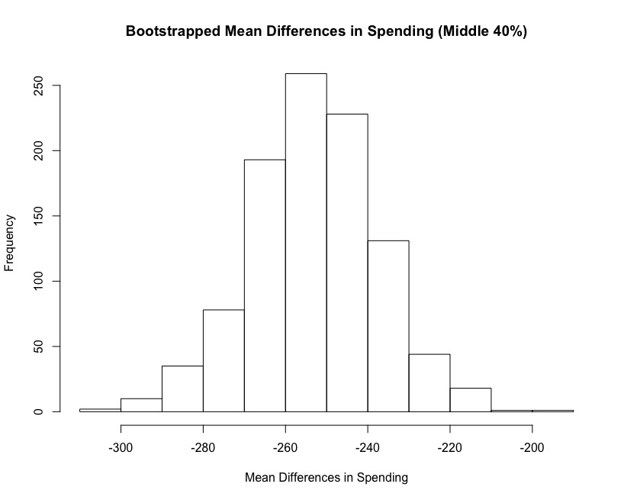
Are customers often paired with others who have similar spending of friends, or is it typically one sided?
Middle Spenders
Result: Middle spenders tend to spend $250 less than the friends they shop with.
Insight:
Customers in the middle 40% of spending typically spend slightly less than the friends they shop with.

Slide 40
What can we conclude on customers?
Customers who pull their friends to shop with them rather than being pulled themselves are most likely the customers that are driving revenue.
More often customers spend less than the friends they bring, unless these customers are very high spenders.
Notes:
Group insights at end

Slide 41
Business Recommendations

Slide 42
Implement efficient spending strategy
(1) Utilize customer targeting database to identify high-value customers
Monthly Revenue ($)
High-value customers
Treatment
Control
Low-value customers
Treatment
Identify high-value customers
Set up treatment and control groups
Control
Run experiment for 3-6 months
Evaluate results
Define metric to track and forecast metric performance
Causal Inference:
Is difference in actual metric performance and forecasts statistically significant?
Track metric
Notes:
Include kicker here

Slide 43
Implement efficient spending strategy
(2) Test effectiveness of new strategy with causal inference experiment
Monthly Revenue ($)
High-value customers
Treatment
Control
Low-value customers
Treatment
Identify high-value customers
Set up treatment and control groups
Control
Run experiment for 3-6 months
Evaluate results
Define metric to track and forecast metric performance
Causal Inference:
Is difference in actual metric performance and forecasts statistically significant?
Track metric
Notes:
Include kicker here

Slide 44
Concluding Thoughts

Slide 45
Revisiting our journey
Primary Objective
Improve the efficiency of promotional spend via the existing loyalty program.
Key Results Needed
Define efficiency of spend
Quantify efficiency of spend
Implement efficient spending strategy
Key Deliverables
Maximize ROI by targeting high-value customers
Utilize machine learning techniques to identify high-value customers
Execute experiment to determine causal inference

Slide 46
Revisiting our journey
Secondary Objectives
Explore data on full-graph level and zipcode-level
Deep dive into customer relationships
Key Results Needed
Are there links between the size / strength of networks and certain zip codes and neighborhood-types in Seattle?
How balanced are relationships?
Are customers often paired with others who have similar number of friends, or is it typically one sided?
Similarly for revenue – big spenders with big spenders or not?
Key Deliverables
There do not seem to be any links between network attributes and zip codes. However there is weak signal with certain demographic attributes.
The subgraph size of customers is quite balanced. Spending is moderately different at lower to mid levels of spending, but extremely different at high levels of spending.

Slide 47
Next steps for improved analyses
Include data on customer response rate to loyalty program promotions
Why? A key factor in determining who to target with the loyalty program.
Account for time series and seasonal effects in revenue calculations
Why? Eliminate confounding factors in the data.
Collect more data on zipcode-level network behavior and demographic attributes; explore further
Why? Improve analysis on zipcode-level targeting

Slide 48
Questions?
Thank you for your time.

Slide 49
Appendix
Contains methodology of analysis and other bonus content!

Slide 50
Methodology: Revenue Analysis
Full graph, Inter-zipcode (i.e. 23 subsets – one for ea. zip)
Pre-processing:
Remove observations with out-degrees < 1 or in-degrees < 1 (cannot log corresponding revenues if zeros are kept)
Feature engineering: 14 features from data
4 features (revenue types) to be used as response variables
Training:
Train on each revenue type (response variable) one at a time
5-fold cross-validation
Models:
L1-regularized OLS regression (1000 times with different seed)
Count most frequent features selected, average coefficients
Random forest (500 trees)
Record variable importance (% increase in MSE)
Most important features selected using results from both models
Intra-zipcode
Pre-processing:
Group customers into their respective zipcodes
Feature engineering: 9 features from data
Response variable is “average spending of customers in zipcode_{i}”
Training:
Lasso regression and random forest (same as above)
Most important features selected using results from both models

Slide 51
Methodology: Relationships Analysis
Difference in size of friend groups of customer pairs?
Metrics to test:
Total degree (Out degree + In degree)
Out degree
In degree
Hypothesis testing:
Bootstrapped t-tests (1000x)
Result is distribution of mean difference in degrees
Difference in spending of customer pairs and different segments of customer spending?
Setting thresholds
Define high-spending: Top…1%, 5%, 10%, 25%
Define low-spending: Bottom…1%, 5%, 10%, 25%
Define middle-spending: Middle…40%
Subset data at each threshold level
Bootstrapped t-tests (1000x) for differences of means in spending at each thresholds

